Slide 1

INSTRUCTIONS FOR CREATING A PORTRAIT
POSTER FOR THE 2023 ENGINE CAPSTONE SHOWCASE
QUESTIONS? EMAIL: PR_TEAM@ECE.UW.EDU
DOWNLOAD (.PPTX) AND VIEW THE EXAMPLE AND
BLANK SLIDE TEMPLATES
Open in PowerPoint and navigate them using the slide thumbnails on the left.
2. WE’VE COPIED THE BLANK TEMPLATES TO NEW SLIDES (4) and (5) FOR YOU TO BEGIN CREATING THE POSTER OF YOUR CHOICE.
If you’d like to create different versions of your poster, right click and choose “DUPLICATE SLIDE” in PowerPoint.
3. TO DISPLAY GUIDES: Select VIEW - GUIDES in the PowerPoint top menu bar.
4. WHEN FINISHED, SAVE AS BOTH .PPTX and PDF files
5. SUBMIT YOUR FINISHED POSTER FILES TO THE FOLLOWING GOOGLE DRIVE:
(https://drive.google.com/drive/folders/1bsnszMeNGgoWdyr6cavJjHDw-vO99L--?usp=share_link)
6. IMPORTANT!! DO NOT CHOOSE TO ‘OPEN WITH GOOGLE SLIDES’
Your poster template will not be formatted properly. Download this file first and open/work within PowerPoint.
*PREFERRED FONTS ARE USED IN THIS SAMPLE PRESENTATION: “ENCODE SANS” FOR TITLES AND “OPEN SANS” FOR BODY TEXT – These can be downloaded and installed on your computer for free here: https://www.washington.edu/brand/graphic-elements/font-download/

Slide 2
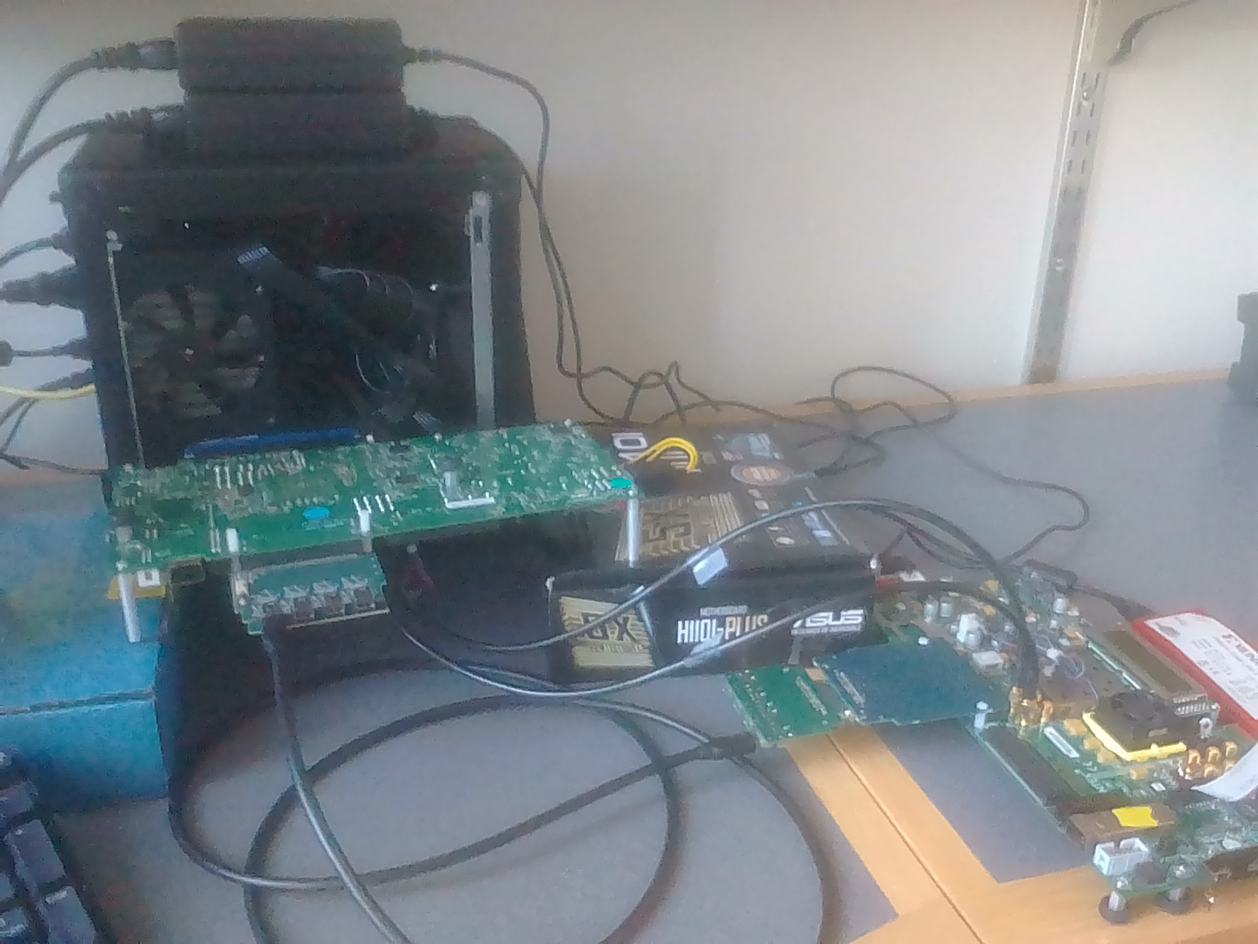
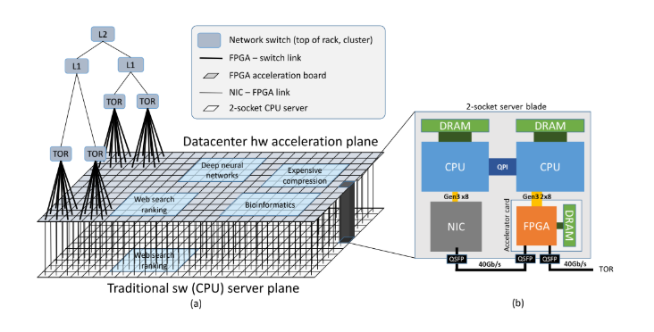
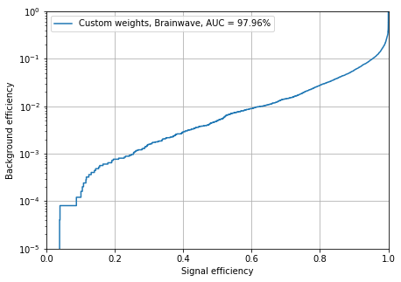
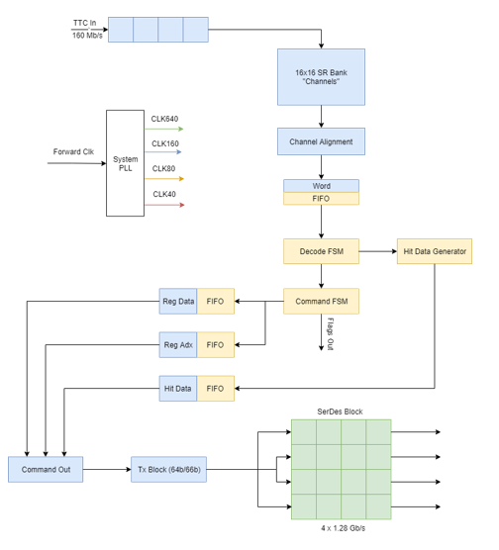
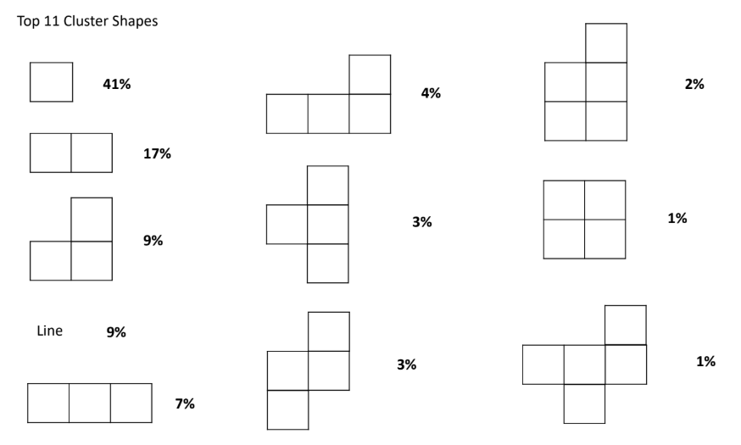
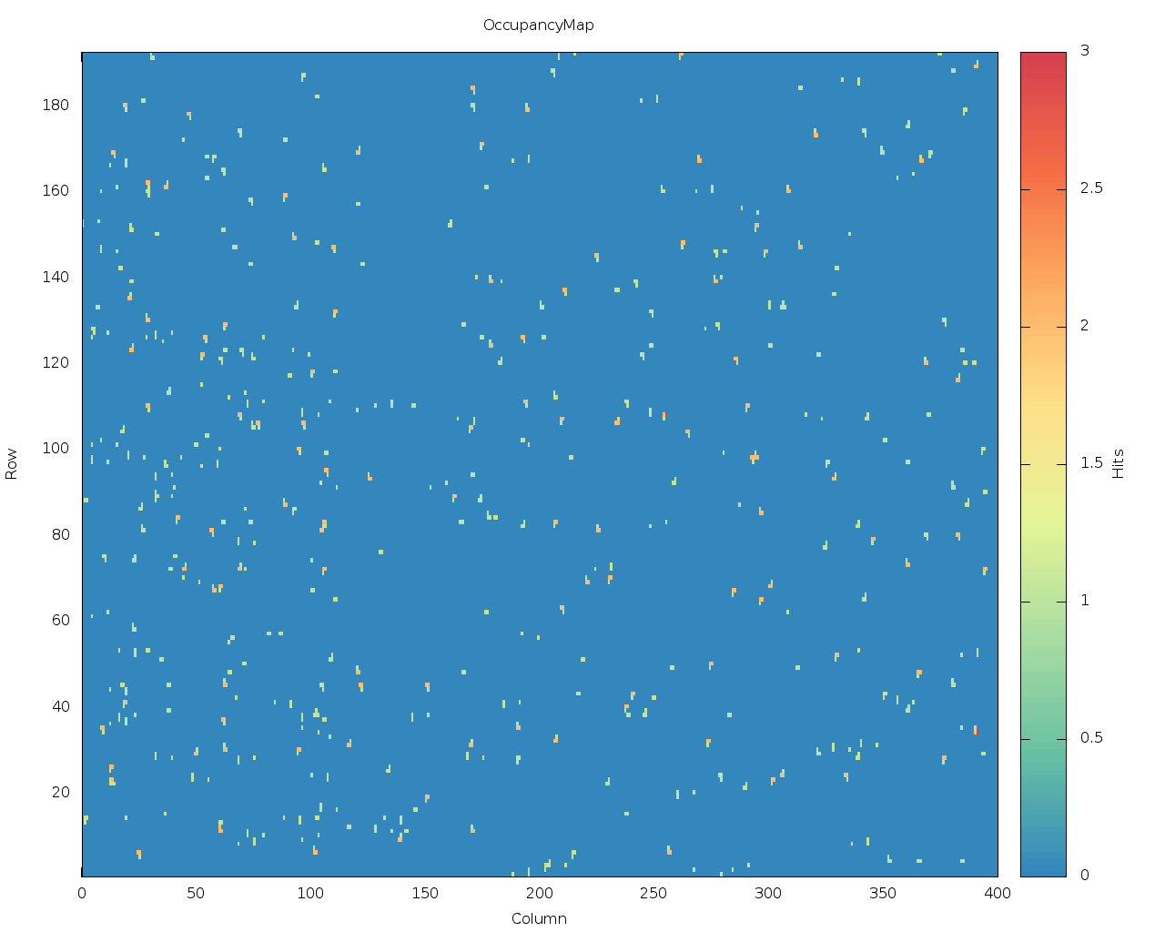
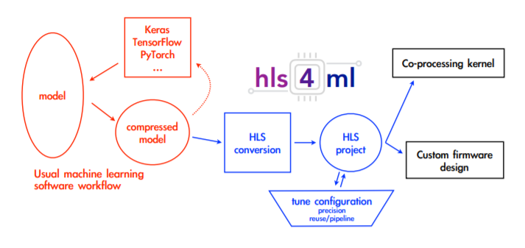
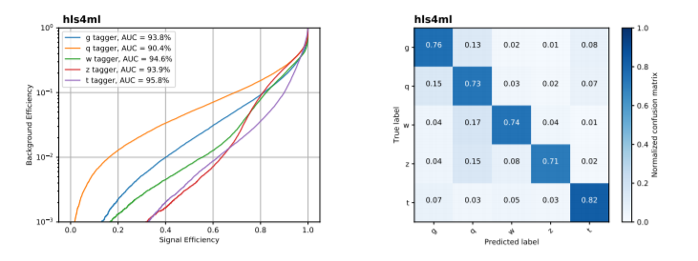
HARDWARE ACCELERATION APPLICATIONS
FOR THE LARGE HADRON COLLIDER
Sponsor Company Logo
STUDENTS: DOUGLAS SMITH, DUSTIN WERRAN, SCOTT HAUCK
The Large Hardon Collider
Machine Learning Acceleration for HEP
The Large Hadron Collider (LHC) is the largest particle collider in the world. Physicists are interested in observing rare events by colliding two high energy particle beams.
An upcoming upgrade to the detector will substantially increase the amount of collisions per second.
New technologies are being developed to cope with the substantial increase in particle flux.
Machine Learning is a popular solution to HEP issues, like hit tagging.
However, ML needs hardware acceleration to be effective at large scale.
ACME Lab is working with CMS at Fermilab to make machine learning acceleration accessible to the HEP community.
ML Acceleration in the Cloud
RD53A Emulator
Microsoft provides a cloud service called Brainwave, which applies FPGAs to the task of machine learning acceleration.
We are doing research into the efficacy of Brainwave for HEP applications.
Results look promising in the area of Top quark tagging.
ACME Lab is developing an FPGA emulator of the LHC RD53A chip.
The Emulator is able to recreate accurate hit signatures without actually being exposed to radiation, greatly simplifying its use.
The emulator can be used for stress testing and can easily be reconfigured to target specific test cases.
Emulator Features
[1]
Hit Data/ Hit Generator
Input data is received at 160 MBPS and is decoded using the custom RD53A protocol.
The received data is split into system commands and triggers (requests for hit data) and each is sent to their respective response units.
Commands are decoded and processed into appropriate system behavior such as rd-reg or wr-reg.
Triggers are processed and produce hit data.
Command and trigger output are combined into one data stream.
This data is split over four lanes and is encoded using Aurora 64/66B at 640 Mbps.
One of our main goals in the RD53A project is to produce realistic data that matches what would be seen in the LHC.
To determine what our data should look like we have been using image processing techniques to analyze real data from the LHC.
Our testing has shown that most of the data consists of simple shapes and lines.
Data is pseudo-randomly generated and output from the system via the Aurora lanes described to the right.
A sample image to the right shows a generated hit patterning.
To determine what our data should look like we have been using image processing techniques to analyze real data from the LHC.
Hls4ml
Future Work, References, and Acknowledgments
Further improvements to hls4ml
Scaling up of Brainwave
Finish implementing the RD53A hit data generator
Start planning the upgrade to RD53B, the next test chip
Faculty: Scott Hauck, Shih-Chieh Hsu
Graduate Students: Douglas Smith, Dustin Werran, Richa Rao
Undergraduate Students: Tony Faubert, Jessica Lan, Kylie Lim, Matthew Trahms, Donovan Erickson
FPGAs are a leading candidate for ML acceleration going forward. However, they require specialized knowledge to use.
hls4ml is a tool that takes standard Neural Framework representations of DNNs and compiles them for use on FPGAs without requiring deep knowledge of FPGAs.
[1] A. Caulfield, E. Chung, A. Putnam, H. Angepat, J. Fowers, M. Haselman et al., A cloud-scale acceleration architecture, IEEE Computer Society, October, 2016.
[2] J. Duarte et. al., Fast inference of deep neural networks in FPGAs for particle physics, arXiv:1804.06913v3 [physics.ins-det] 28
ADVISERS: JOHN DOE, ROBERT WALTER, WILLIAM RICHARDS, JANE DOE
SPONSOR: ELECTRICAL & COMPUTER ENGINEERING DEPARTMENT, UNIVERSITY OF WASHINGTON
Notes:
Vertical Example

Slide 3

HARDWARE ACCELERATION APPLICATIONS
FOR THE LARGE HADRON COLLIDER
Sponsor Company Logo
STUDENTS: DOUGLAS SMITH, DUSTIN WERRAN, SCOTT HAUCK
The Large Hardon Collider
Machine Learning Acceleration for HEP
The Large Hadron Collider (LHC) is the largest particle collider in the world. Physicists are interested in observing rare events by colliding two high energy particle beams.
An upcoming upgrade to the detector will substantially increase the amount of collisions per second.
New technologies are being developed to cope with the substantial increase in particle flux.
Machine Learning is a popular solution to HEP issues, like hit tagging.
However, ML needs hardware acceleration to be effective at large scale.
ACME Lab is working with CMS at Fermilab to make machine learning acceleration accessible to the HEP community.
ML Acceleration in the Cloud
RD53A Emulator
Microsoft provides a cloud service called Brainwave, which applies FPGAs to the task of machine learning acceleration.
We are doing research into the efficacy of Brainwave for HEP applications.
Results look promising in the area of Top quark tagging.
ACME Lab is developing an FPGA emulator of the LHC RD53A chip.
The Emulator is able to recreate accurate hit signatures without actually being exposed to radiation, greatly simplifying its use.
The emulator can be used for stress testing and can easily be reconfigured to target specific test cases.
Emulator Features
[1]
Hit Data/ Hit Generator
Input data is received at 160 MBPS and is decoded using the custom RD53A protocol.
The received data is split into system commands and triggers (requests for hit data) and each is sent to their respective response units.
Commands are decoded and processed into appropriate system behavior such as rd-reg or wr-reg.
Triggers are processed and produce hit data.
Command and trigger output are combined into one data stream.
This data is split over four lanes and is encoded using Aurora 64/66B at 640 Mbps.
One of our main goals in the RD53A project is to produce realistic data that matches what would be seen in the LHC.
To determine what our data should look like we have been using image processing techniques to analyze real data from the LHC.
Our testing has shown that most of the data consists of simple shapes and lines.
Data is pseudo-randomly generated and output from the system via the Aurora lanes described to the right.
A sample image to the right shows a generated hit patterning.
To determine what our data should look like we have been using image processing techniques to analyze real data from the LHC.
Hls4ml
Future Work, References, and Acknowledgments
Further improvements to hls4ml
Scaling up of Brainwave
Finish implementing the RD53A hit data generator
Start planning the upgrade to RD53B, the next test chip
Faculty: Scott Hauck, Shih-Chieh Hsu
Graduate Students: Douglas Smith, Dustin Werran, Richa Rao
Undergraduate Students: Tony Faubert, Jessica Lan, Kylie Lim, Matthew Trahms, Donovan Erickson
FPGAs are a leading candidate for ML acceleration going forward. However, they require specialized knowledge to use.
hls4ml is a tool that takes standard Neural Framework representations of DNNs and compiles them for use on FPGAs without requiring deep knowledge of FPGAs.
[1] A. Caulfield, E. Chung, A. Putnam, H. Angepat, J. Fowers, M. Haselman et al., A cloud-scale acceleration architecture, IEEE Computer Society, October, 2016.
[2] J. Duarte et. al., Fast inference of deep neural networks in FPGAs for particle physics, arXiv:1804.06913v3 [physics.ins-det] 28
ADVISERS: JOHN DOE, ROBERT WALTER, WILLIAM RICHARDS, JANE DOE
SPONSOR: ELECTRICAL & COMPUTER ENGINEERING DEPARTMENT, UNIVERSITY OF WASHINGTON
Notes:
Vertical Example

Slide 4
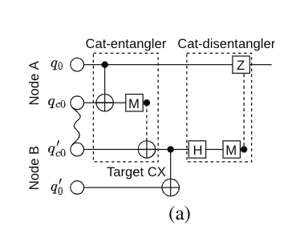
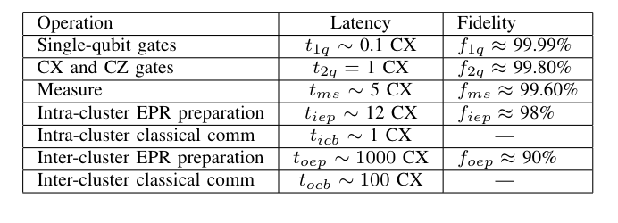
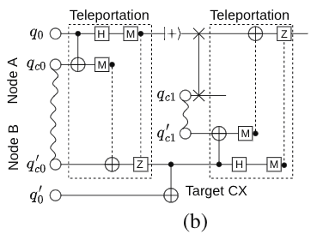
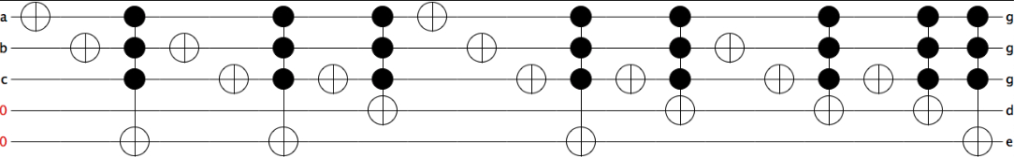
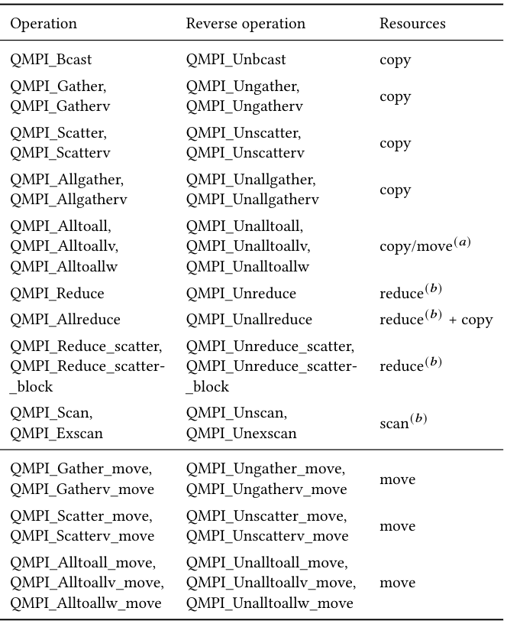
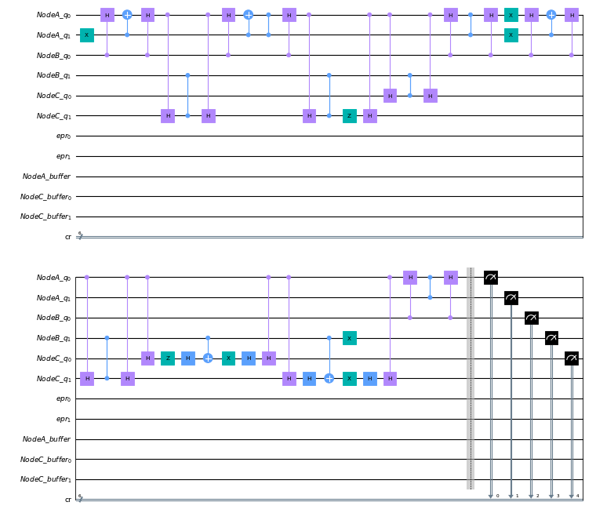
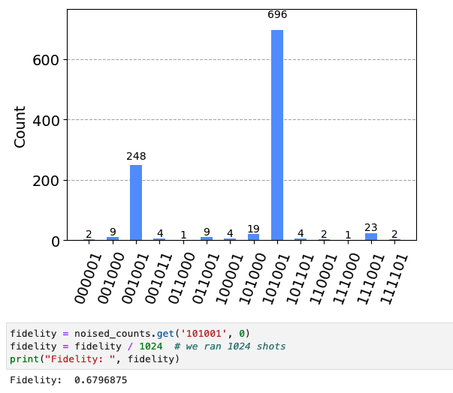
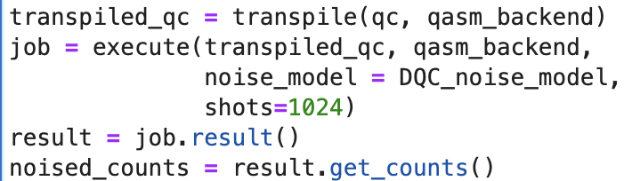
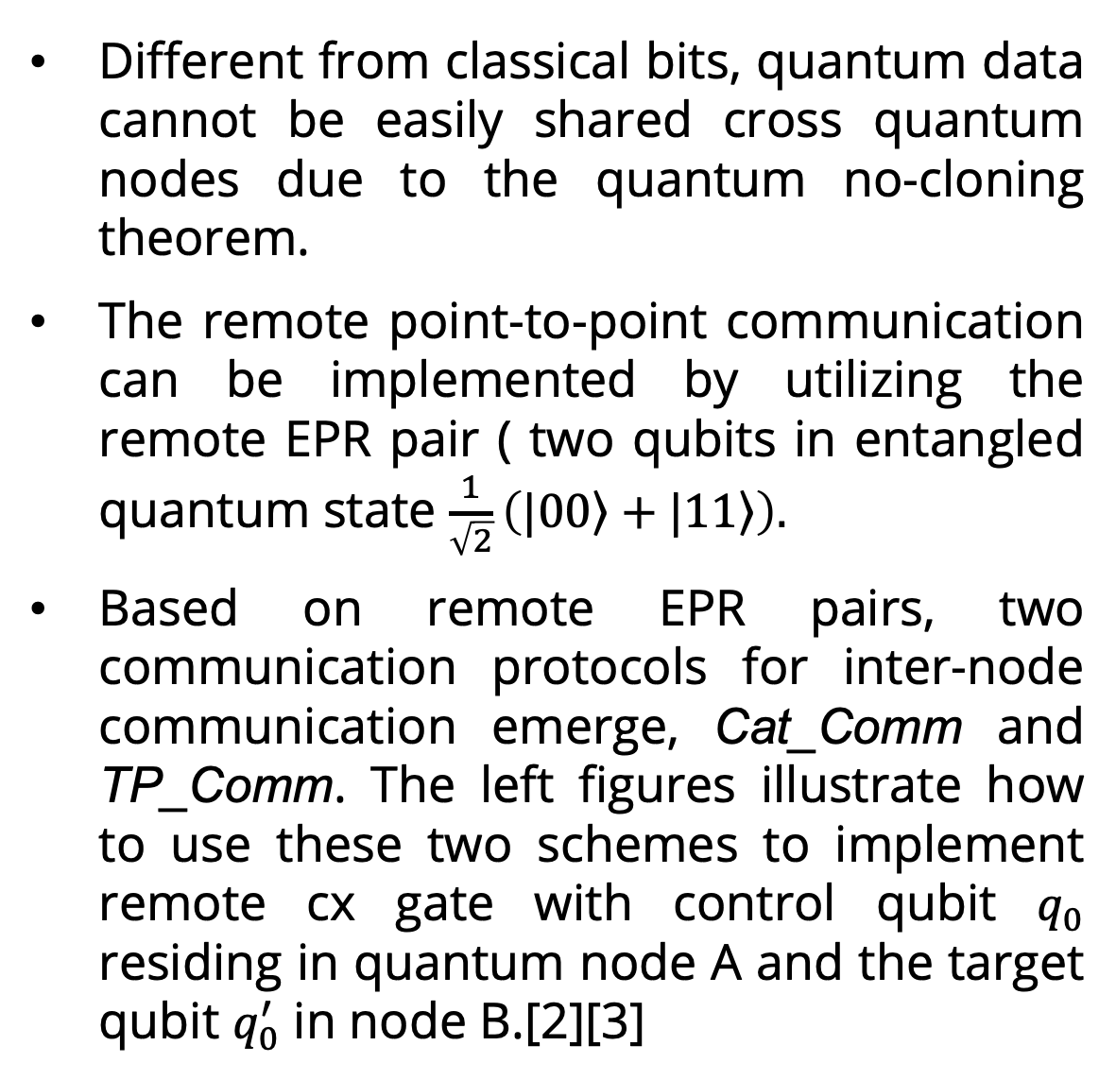
EE 522 Capstone: A Reference Implementation for a Quantum Message Passing Interface (QMPI)
Sponsor Company Logo
STUDENTS: Yue Shi, Tommy Nguyen
Distributed Quantum Computing & Quantum MPI
A strategy for improving collective communication efficiency
Distributed quantum computing can be used to connect multiple quantum processors to overcome the difficulty of finite qubit r
QMPI takes advantages of quantum teleportation to communication between different quantum processors but leverage the framework built for classical MPI.
The operations of QMPI can be simply classified into two types: point-to-point operations, collective operations.[1]
On top of the Auto_Comm and Coll_Comm frameworks, we develop a new strategy for MCT(multi-controlled Toffoli) circuits, which can further reduce the resources consumption and improve the fidelity of collective communication in distributed system. Here are a few steps to implement it:
Decompose the multi-controlled Toffoli gates (with control qubit n > 2) into ccx gate
Transform circuit by utilizing a few gate commutation rules to bring the single qubit gate between two ccx gates backward (avoid internode communication back and forth)
Execute operations locally on one node with help of buffers, then teleport qubit back after execution.
Point-to-point Operations
Different from classical bits, quantum data cannot be easily shared cross quantum nodes due to the quantum no-cloning theorem.
The remote point-to-point communication can be implemented by utilizing the remote EPR pair ( two qubits in entangled quantum state $\frac{1}{\sqrt{2}}\left(\left.|00\right\rangle +\left.|11\right\rangle \right).$
Based on remote EPR pairs, two communication protocols for inter-node communication emerge, Cat_Comm and TP_Comm. The left figures illustrate how to use these two schemes to implement remote cx gate with control qubit $q_{0}$ residing in quantum node A and the target qubit $q_{0}^{′}$ in node B.[2][3]
[2]
Experiment Setup
Platform: simulations are implemented using qasm simulator.
Benchmark circuit: Function rd32 circuit imported from RevLib (shown in figure below). [4]
Noise model: Built according to the parameters reported in previous paper.
Baseline: Coll_Comm DQC compiler
[2]
[2]
Metric: total number of consumed EPR pairs; fidelity of computation.
[4]
Collective operations
Simulation results
In additional to general point-to-point communication, QMPI also provides the collective operations shown in the right table .
The overall existed compliers utilize Cat_Comm for implementing the inter-node remote gates. However, this procedure has a low throughput due to the limited information teleportated per remote EPR pair.
Later, the Burst_communication (a group of continuous remote two-qubit gates between one qubit and node) and Coll_Comm framework based on communication buffers were proposed to optimize the communication overhead of distributed quantum program. They both significantly reduce the resources consumption in the experiments.
[1]
The transformed benchmark circuit rd32 utilizing our strategy is shown in Fig (a).
The simulation is executed by QASM simulator with 1024 shots (Fig. (b)).
The simulation has the correct result with fidelity 68% and five pairs of EPR pairs consumption. Compared with the baseline, the fidelity of computation is significantly improved, and the remote EPR pairs consumption is significantly reduced.
The strategy could also work for other MCT circuits with the similar improvements in the distributed quantum system.
a)
c)
b)
 | Remote EPR pair cost | Fidelity
Using buffers | 14 | 0.442
Optimized | 5 | 0.680
metrics
methods
Future Work, References, and Acknowledgments
1. Develop a complier using our strategy.
2. Implement…
We acknowledge
Advisor: Ang Li, Samuel Stein, Marvin Warner (PNNL)
Faculty: Sara Mouradian, Peter Pauzaiskie (UW)
for their kind help in this project.
References:
[1] Thomas Haner et. al., Distributed quantum computing with QMPI. Proceedings of international conference for high performance computing, network, storage and analysis. November 2021, No.16.
[2] Anbang Wu et. al., AutoComm: A Framework for enabling efficient communication in distributed quantum program. 55th IEEE/ACM International Symposium on Microarchitecture (MICRO), Chicago, IL, USA, 2022, pp. 1027-1041.
[3] Anbang Wu et. al., CollComm: Enabling efficient collective quantum communication based on EPR buffering. arXiv: 2208.06724v2
[4] https://www.revlib.org
ADVISERS: Ang Li, Samuel Stein, Marvin Warner (PNNL)
SPONSOR: ELECTRICAL & COMPUTER ENGINEERING DEPARTMENT, UNIVERSITY OF WASHINGTON
Notes:
Vertical Example

Slide 5
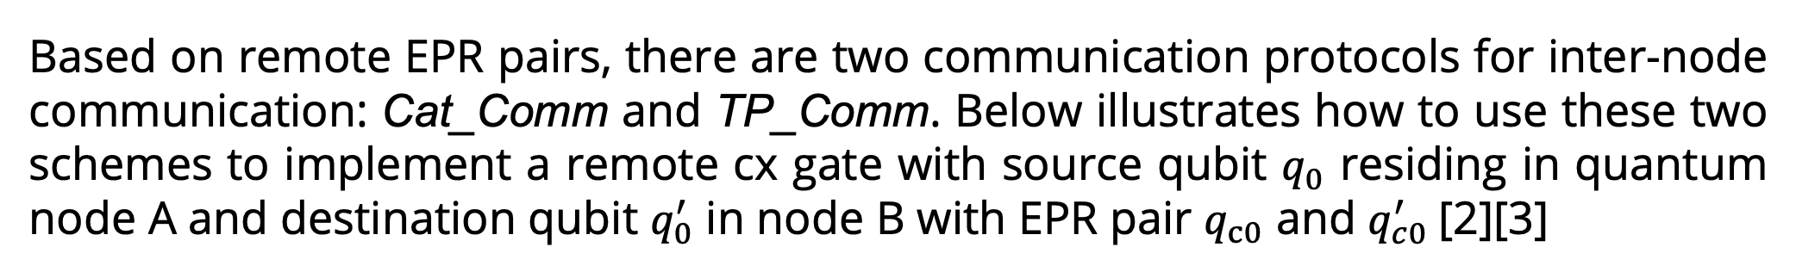
EE 522 Capstone: A Reference Implementation for a Quantum Message Passing Interface (QMPI)
Sponsor Company Logo
STUDENTS: Yue Shi, Tommy Nguyen
Distributed Quantum Computing & Quantum MPI
A strategy for improving collective communication efficiency
Scalability: Distributed Quantum Computing and QMPI can be used to connect multiple quantum processors to overcome the difficulty of finite qubit resources, especially in the NISQ era where noise is correlated with qubit number
Interoperability: QMPI is an important step for creating a standard communication protocol between different quantum computers. This ensures interoperability between quantum devices from different hardware, just as MPI does for classical computers. This is vital in developing a global quantum internet, where quantum computers can communicate and collaborate effectively
Quantum Advantage: Distributed Quantum Computing and QMPI are crucial for harnessing the full potential of quantum computers. By distributing quantum resources, latency can be potentially increased for complex computations, thereby enhancing the quantum advantage
On top of the Auto_Comm and Coll_Comm frameworks, we develop a new strategy for MCT(multi-controlled Toffoli) circuits, which can further reduce the resources consumption and improve the fidelity of collective communication in distributed system. Here are a few steps to implement it:
Decompose the multi-controlled Toffoli gates (with control qubit n > 2) into ccx gate
Transform circuit by utilizing a few gate commutation rules to bring the single qubit gate between two ccx gates backward (avoid internode communication back and forth)
Execute operations locally on one node with help of buffers, then teleport qubit back after execution.
Experiment Setup
Quantum Message Passing Interface (QMPI)
Platform: simulations are implemented using qasm simulator.
Benchmark circuit: Function rd32 circuit imported from RevLib (shown in figure below). [4]
Noise model: Built according to the parameters reported in previous paper.
Baseline: Coll_Comm DQC compiler
[2]
The QMPI is a communication framework for distributed quantum computation inspired by the classical MPI used in high-performance classical computing. We have developed the QMPI framework in Qiskit and built an API for users
Point to Point Communication
Based on remote EPR pairs, there are two communication protocols for inter-node communication: Cat_Comm and TP_Comm. Below illustrates how to use these two schemes to implement a remote cx gate with source qubit $q_{0}$ residing in quantum node A and destination qubit $q_{0}^{′}$ in node B with EPR pair $q_{c0}$ and $q_{c0}^{′}$[2][3]
[4]
[2]
[2]
Simulation results
The transformed benchmark circuit rd32 utilizing our strategy is shown in Fig (a).
The simulation is executed by QASM simulator with 1024 shots (Fig. (b)).
The simulation has the correct result with fidelity 68% and five pairs of EPR pairs consumption. Compared with the baseline, the fidelity of computation is significantly improved, and the remote EPR pairs consumption is significantly reduced.
The strategy could also work for other MCT circuits with the similar improvements in the distributed quantum system.
a)
Cat_Comm
TP_Comm
Send and unsend are implemented with TP_comm using 2 buffered EPR pairs for each node
Receive is implemented using feedback from the classical measurements in TP_Comm for blocking functionality
Designed an interface to replace any quantum circuit with remote multi-qubit gates into one that uses QMPI’s point to point communication
Collective Communication
Gather
c)
b)
Broadcast
 | Remote EPR pair cost | Fidelity
Using buffers | 14 | 0.442
Optimized | 5 | 0.680
metrics
methods
Scatter
Allgather
Future Work, References, and Acknowledgments
Reduce
1. Develop a complier using our strategy.
2. Implement…
We acknowledge
Advisor: Ang Li, Samuel Stein, Tim Stavenger Marvin Warner (PNNL)
Faculty: Sara Mouradian, Peter Pauzaiskie (UW)
for their kind help in this project.
References:
[1] Thomas Haner et. al., Distributed quantum computing with QMPI. Proceedings of international conference for high performance computing, network, storage and analysis. November 2021, No.16.
[2] Anbang Wu et. al., AutoComm: A Framework for enabling efficient communication in distributed quantum program. 55th IEEE/ACM International Symposium on Microarchitecture (MICRO), Chicago, IL, USA, 2022, pp. 1027-1041.
[3] Anbang Wu et. al., CollComm: Enabling efficient collective quantum communication based on EPR buffering. arXiv: 2208.06724v2
[4] https://www.revlib.org
Allreduce
Gates
Gates
Applications:
Transverse Ising Model – broadcast
Quantum Phase Estimation – reduce/gather
ADVISERS: JOHN DOE, ROBERT WALTER, WILLIAM RICHARDS, JANE DOE
SPONSOR: ELECTRICAL & COMPUTER ENGINEERING DEPARTMENT, UNIVERSITY OF WASHINGTON
Notes:
Vertical Example

Slide 6

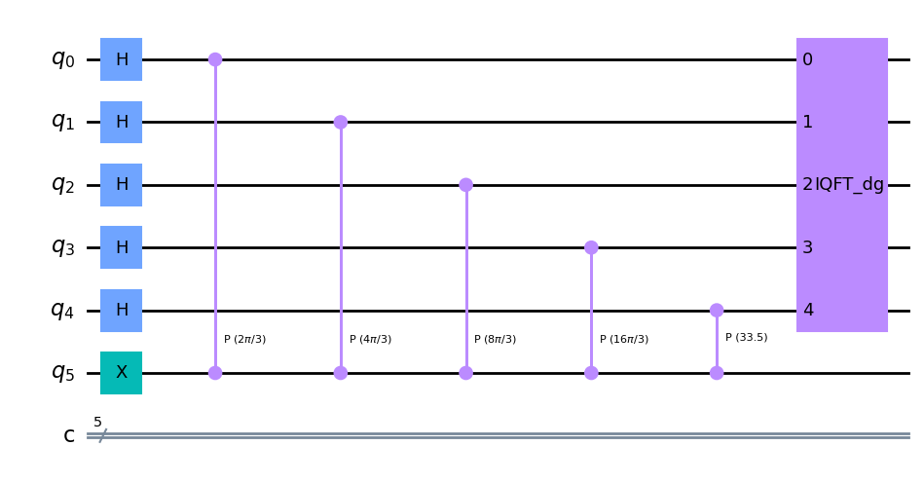
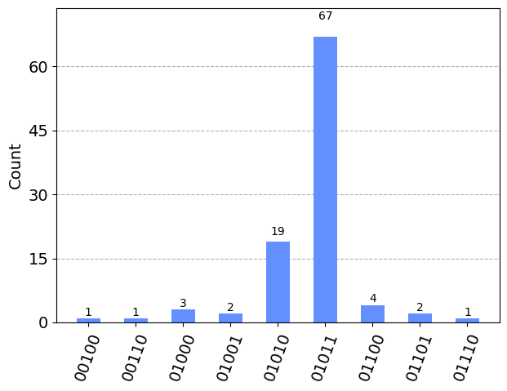
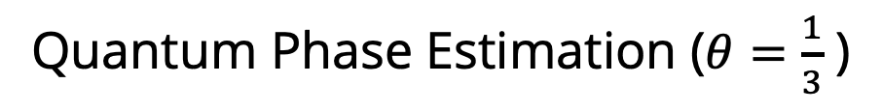
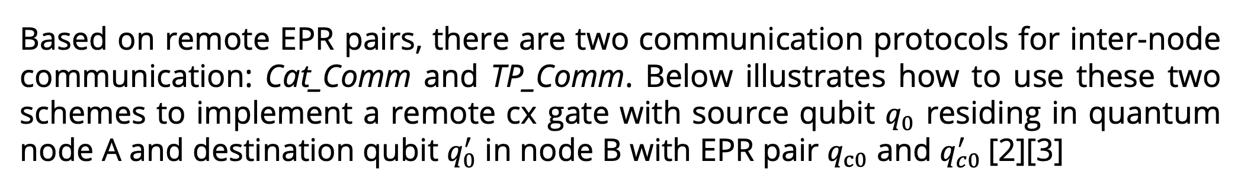
EE 522 Capstone: A Reference Implementation for a Quantum Message Passing Interface (QMPI)
STUDENTS: Yue Shi, Tommy Nguyen
Distributed Quantum Computing & Quantum MPI
A Strategy for improving Collective Communication Efficiency
Scalability: Distributed Quantum Computing and QMPI can be used to connect multiple quantum processors to overcome the difficulty of finite qubit resources, especially in the NISQ era where noise is correlated with qubit number
Interoperability: QMPI is an important step for creating a standard communication protocol between different quantum computers. This ensures interoperability between quantum devices from different hardware, just as MPI does for classical computers. This is vital in developing a global quantum internet, where quantum computers can communicate and collaborate effectively
Quantum Advantage: Distributed Quantum Computing and QMPI are crucial for harnessing the full potential of quantum computers. By distributing quantum resources, latency can be increased for complex computations, thereby enhancing the quantum advantage
On top of the Auto_Comm and Coll_Comm frameworks [2][3], we develop a new strategy for quantum circuits with MCT (multi-controlled Toffoli) gates. This can reduce resource consumption and improve the fidelity of collective communication in distributed quantum systems.
Circuits with MCT gates
Decompose MCT gates with qubits distributed
Check the internode communication distribution
Allocate the buffer qubits to each nodes
Execute computation on DQC with help of buffers
Iteratively search the single qubit gates between
Move it backward using gates commutation rule
Avoid internode communication back forth
Experiment Setup
Quantum Message Passing Interface (QMPI)
Platform: simulations implemented on QASM simulator
Benchmark circuit: Function rd32 circuit imported from RevLib (as shown below) [4]
Noise model: Built according to the parameters in the Coll_Comm paper [3]
Baseline: Coll_Comm DQC compiler
[2]
The QMPI is a communication framework for distributed quantum computation inspired by the classical MPI used in high-performance classical computing. We have developed the QMPI framework in Qiskit and built an API for users
Point to Point Communication
Metrics: total number of consumed EPR pairs and fidelity of computation
[4]
Based on remote EPR pairs, there are two communication protocols for inter-node communication: Cat_Comm and TP_Comm. Below illustrates how to use these two schemes to implement a remote cx gate with source qubit $q_{0}$ residing in quantum node A and destination qubit $q_{0}^{′}$ in node B with EPR pair $q_{c0}$ and $q_{c0}^{′}$[2][3]
[2]
[2]
Simulation Results
Our MCT technique produces the correct result with 68% fidelity when simulating the benchmark circuit and uses 5 EPR pairs. The fidelity greatly improved over the baseline (44%), and the usage of remote EPR pairs significantly decreased.
The MCT strategy works for other quantum circuits with MCT gates with improvements on the distributed quantum system.
We implemented Quantum Phase Estimation with Gather and the trotterization of the Transverse Ising Model with Scatter to test our QMPI framework
a)
Cat_Comm
TP_Comm
Send and unsend are implemented with TP_Comm using 2 buffered EPR pairs for each node
Receive is implemented using feedback from the classical measurements in TP_Comm for blocking functionality
We designed an interface to replace any quantum circuit with remote multi-qubit gates into one that uses QMPI’s point to point communication
b)
 | Remote EPR pair cost | Fidelity
Using buffers | 14 | 0.442
Optimized | 5 | 0.680
metrics
methods
Collective Communication
Quantum Phase Estimation ($θ=\frac{1}{3}$ )
Broadcast
Gather
Scatter
Allgather
Gather into last Quantum Node
(0.313)
(0.344)
Future Work, References, and Acknowledgments
Reduce
Allreduce
Develop a compiler combining our MCT strategy with the QMPI framework
Implement more applications within the QMPI framework and MCT and compare fidelities, latencies, and # of EPR pairs
Further optimizations using strategies within Auto_Comm and Coll_Comm that would be automatic within QMPI
Generalize QMPI for quantum architectures that doesn’t assume all-to-all connectivity
We acknowledge
Advisor: Ang Li, Samuel Stein, Tim Stavenger, Marvin Warner (PNNL), Martin Roetteler (Microsoft)
Faculty: Sara Mouradian, Peter Pauzaiskie (UW)
for their kind help in this project.
References:
[1] Thomas Haner et. al., Distributed quantum computing with QMPI. Proceedings of international conference for high performance computing, network, storage and analysis. November 2021, No.16.
[2] Anbang Wu et. al., AutoComm: A Framework for enabling efficient communication in distributed quantum program. 55th IEEE/ACM International Symposium on Microarchitecture (MICRO), Chicago, IL, USA, 2022, pp. 1027-1041.
[3] Anbang Wu et. al., CollComm: Enabling efficient collective quantum communication based on EPR buffering. arXiv: 2208.06724v2
[4] https://www.revlib.org
Gates
Gates
Potential Applications:
Transverse Ising Model – Broadcast, Scatter
Quantum Phase Estimation – Reduce/Gather
Quantum Key Distribution – Allgather
VQE/QAOA – Scatter, Reduce
Quantum Arithmetic – Allreduce
ADVISERS: Ang Li, Samuel Stein, Tim Stavenger, Marvin Warner (PNNL); Martin Roetteler (Microsoft)
SPONSOR: ELECTRICAL & COMPUTER ENGINEERING DEPARTMENT, UNIVERSITY OF WASHINGTON
Notes:
Vertical Example

